Slide 1
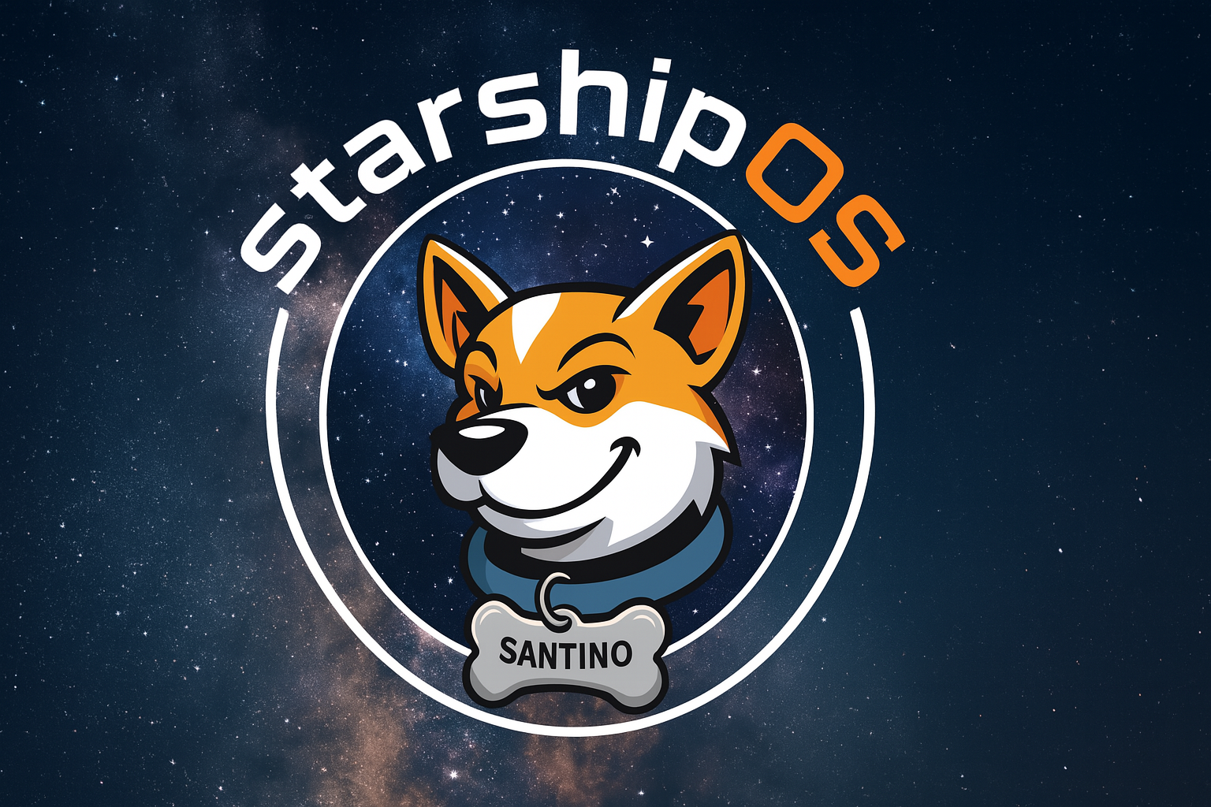
StarForth: A Verified Forth VM for StarshipOS
Captain Bob — StarshipOS Project
Formally Verified, Deterministic, and Open Source
Built for StarshipOS, the capability-based OS

Slide 2
Why Verification Matters
Forth VMs power safety-critical devices.
Stack corruption or underflow can destabilize entire systems.
Formal proofs provide exhaustive guarantees beyond testing.

Slide 3
State of the Art
Power & Sinclair (2004): Formal model of Forth control words in π-calculus.
Stoddart (2012): Forth semantics for compiler verification subset.
No full verified runtime VM exists.

Slide 4
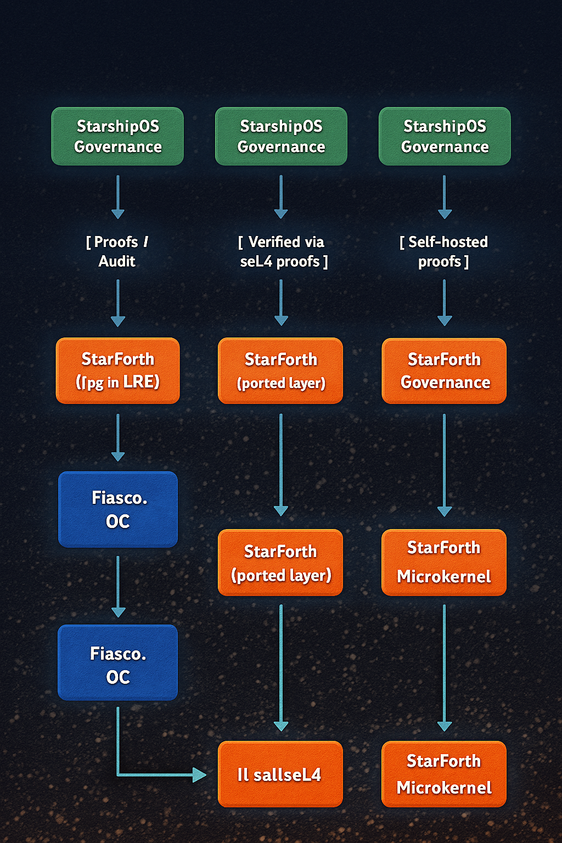
StarForth’s Approach
Machine-checked semantics in Isabelle/HOL.
Proofs for stack safety, underflow, and primitive correctness.
Reference VM aligned 1:1 with formal definitions.

Slide 5
What Makes It Unique
First open-source Forth VM with full primitive proof corpus (to our knowledge).
Mathematically verified runtime core integrated with StarshipOS.
Bridging deterministic computation with formal validation.

Slide 6
Verification & Testing Strategy
Proofs: logical soundness and stack invariants in Isabelle.
Harness: runs all registered primitives with edge-case coverage.
Tests only required for VM integration and I/O.

Slide 7
SDK & Community Model
StarshipOS SDK ships free with StarForth Core.
Encourages experimentation and open contribution.
Pro tiers: certified builds and enterprise verification support.

Slide 8
Market & Applications
Embedded and aerospace safety systems.
Educational and research verification frameworks.
Deterministic compute for simulation and automation.

Slide 9
Roadmap
Expand proof coverage to complete word set.
Integrate file/block dual model for StarForth development.
Publish formal proof corpus in Archive of Formal Proofs.

Slide 10
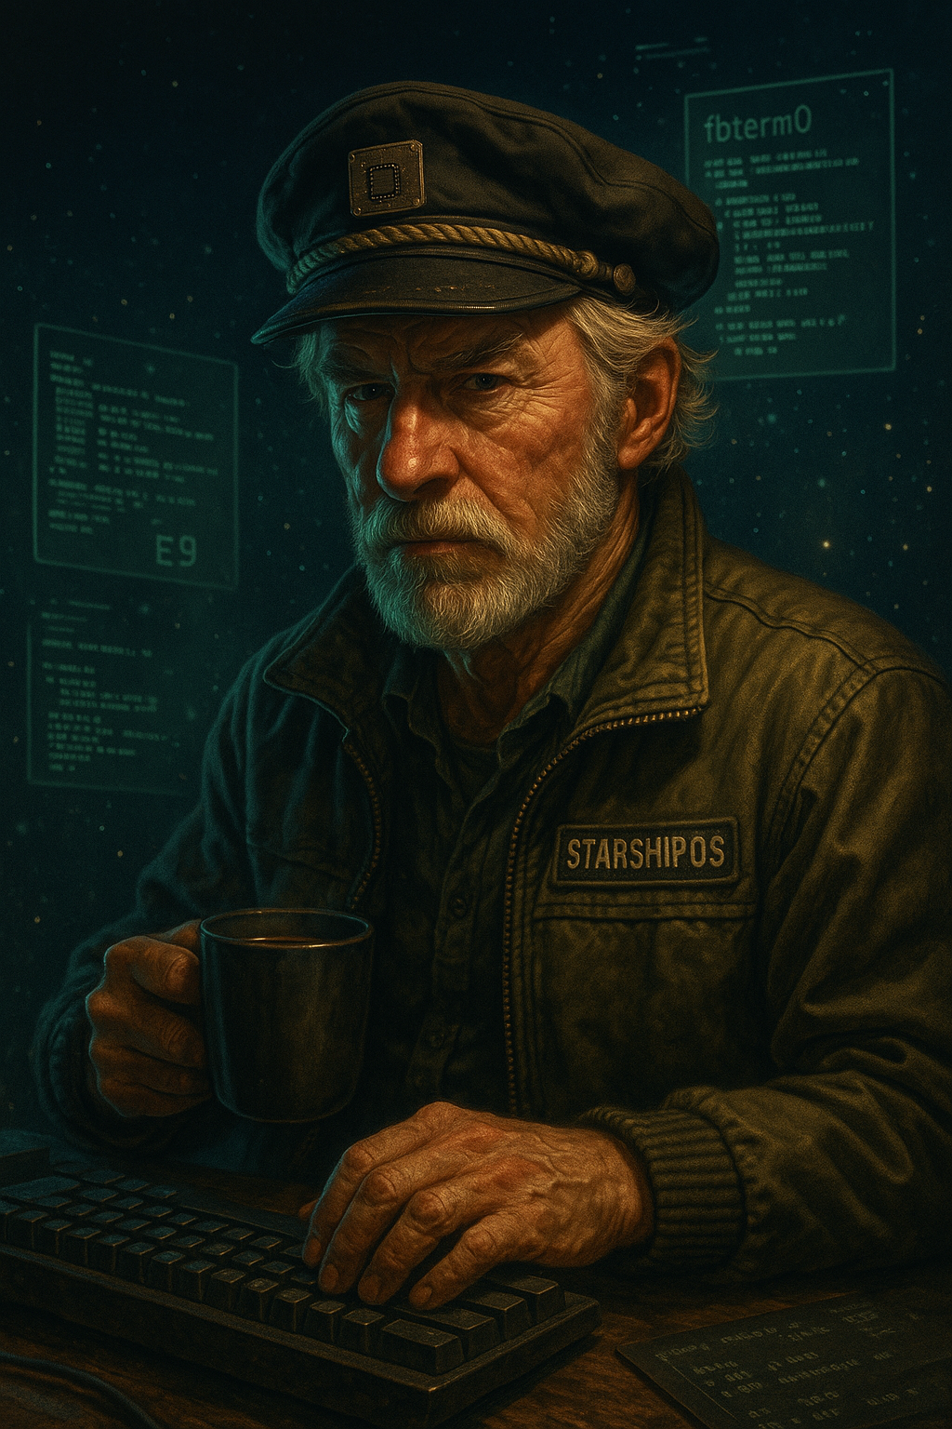
Join the Mission
Contribute to the first verifiable OS.
Use the free SDK or sponsor verification work.
Visit github.com/rajames440 for details.
StarForth + StarshipOS: Proof-Driven Computing.

